Slide 1
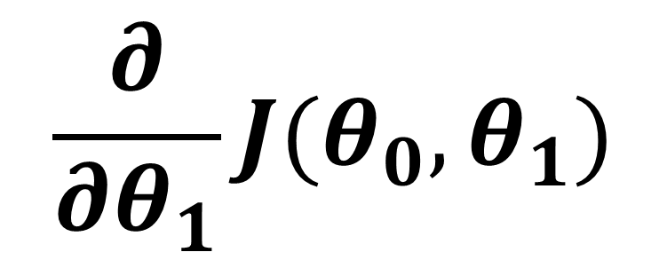
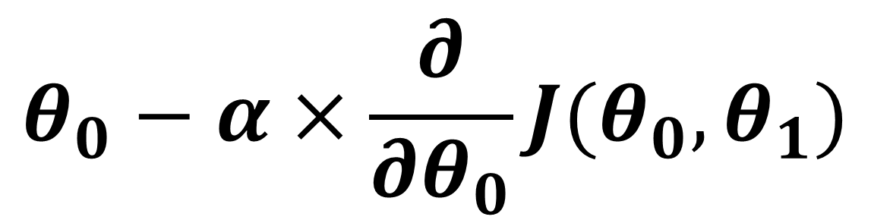

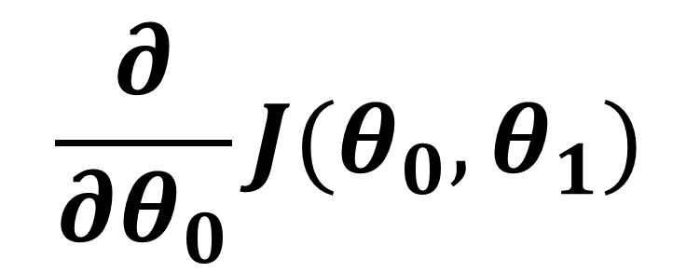
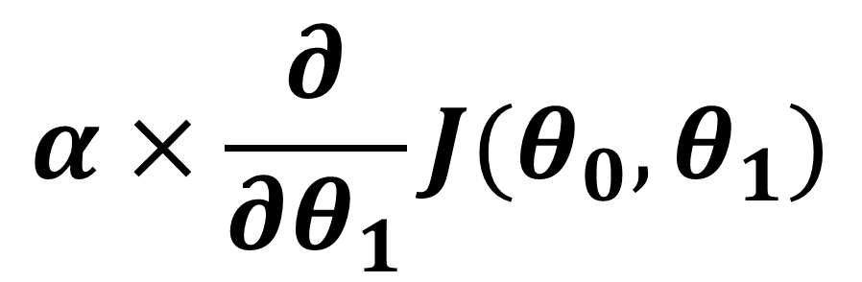


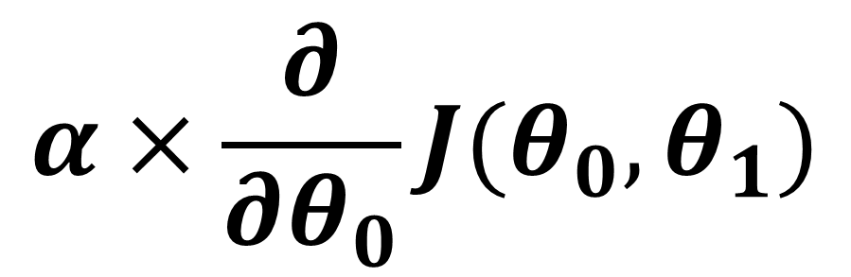
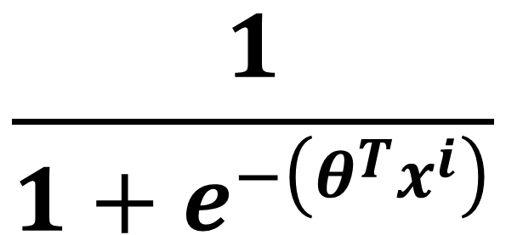



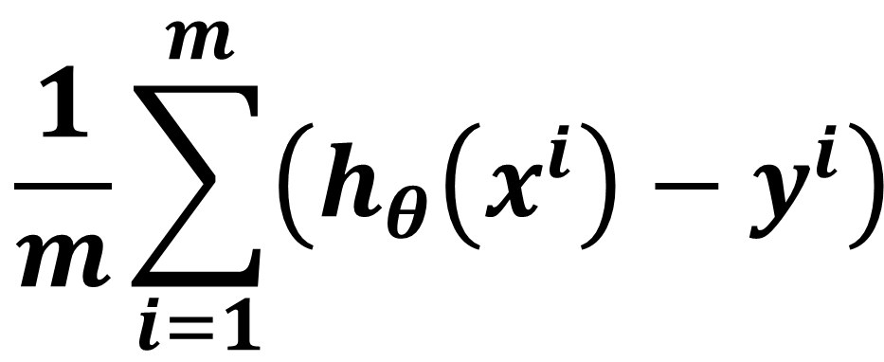
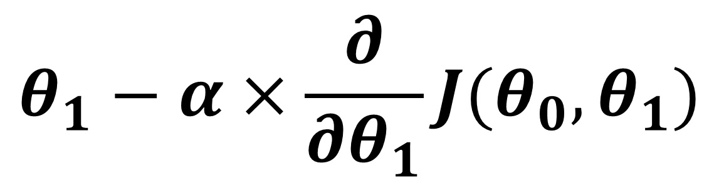
Logistic Regression workbook
$$θ_{0}$$
$$θ_{1}$$
$$\frac{∂}{∂θ_{0}}J(θ_{0},θ_{1})$$
$$\frac{∂}{∂θ_{1}}J(θ_{0},θ_{1})$$
0 | 0
$$h_{θ}(x^{i})$$
$$\frac{1}{m}\sum_{i=1}^{m}{\left({h_{θ}\left(x^{i}\right)−y}^{i}\right)}$$
$$\frac{1}{m}\sum_{i=1}^{m}{\left({h_{θ}\left(x^{i}\right)−y}^{i}\right)\text{. }x^{i} }$$
$$\frac{1}{1+e^{−\left(θ^{T}x^{i}\right)}}$$
$$α×\frac{∂}{∂θ_{0}}J(θ_{0},θ_{1})$$
$$θ_{0}−α×\frac{∂}{∂θ_{0}}J(θ_{0},θ_{1})$$
$$\left(θ^{T}x^{i}\right)$$
$$y^{i}$$
1 | 1
1 | 2
1 | 3
1 | 4
0
0
1
1
$$α×\frac{∂}{∂θ_{1}}J(θ_{0},θ_{1})$$
$$θ_{1}−α×\frac{∂}{∂θ_{1}}J(θ_{0},θ_{1})$$

